Slide 1
Health and wellbeing
Under the influence of Covid-19
Survey conducted in April 2022 by the Erasmus+ Project:
LET’S ENJOY CULTURE AGAIN
The survey had 200 respondents from the countries:
Germany, Turkey, Spain, Norway and Denmark

Slide 2
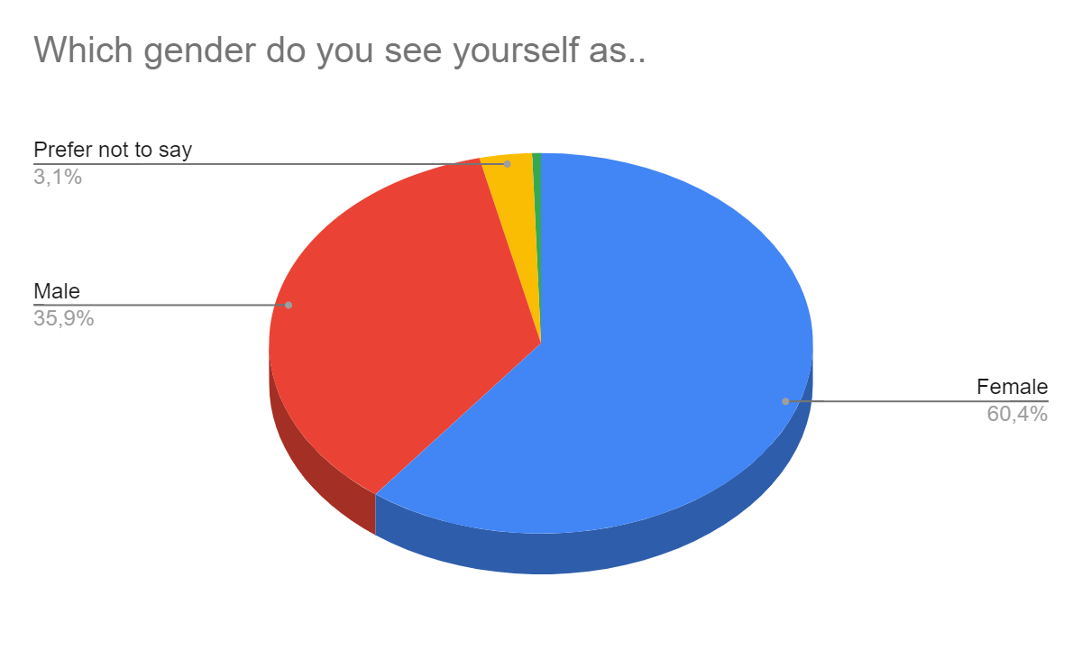
Who were the respondents by gender?

Slide 3
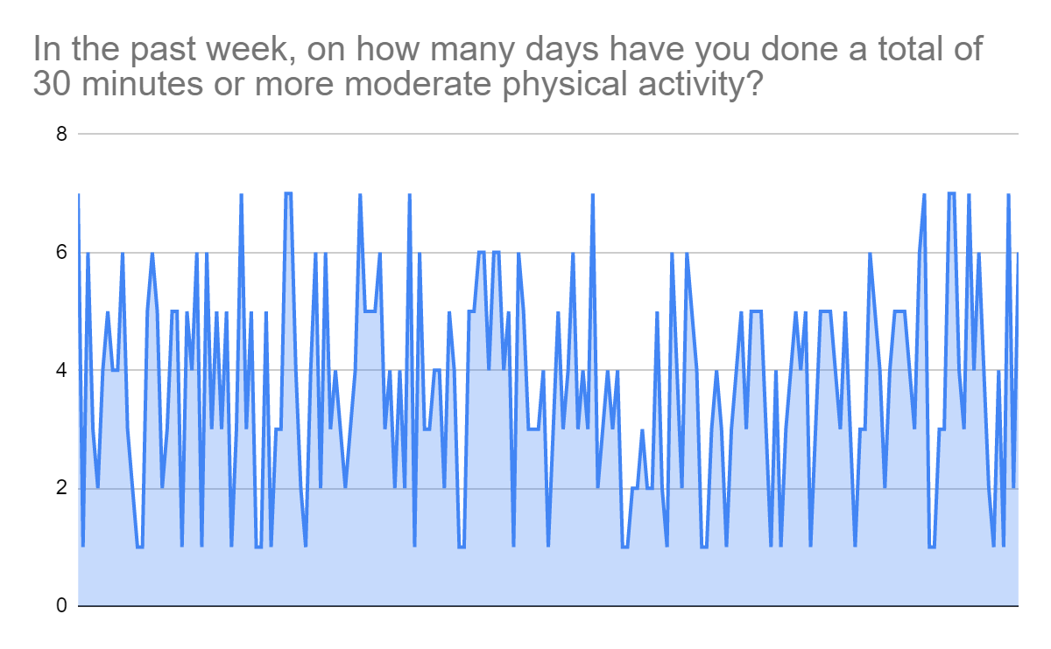
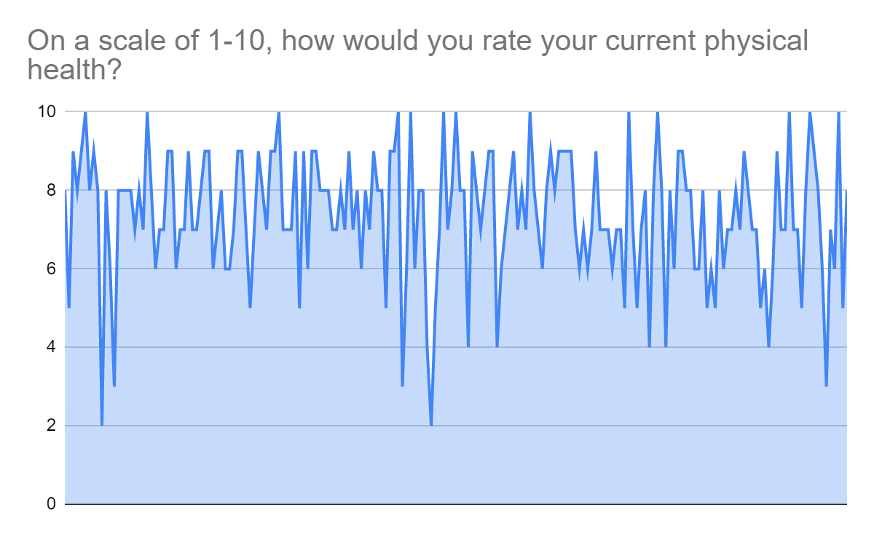
Do you do, what you say you do?
QUESTION: How much do you pay attention to physical activities vs. non physical activities?

Slide 4
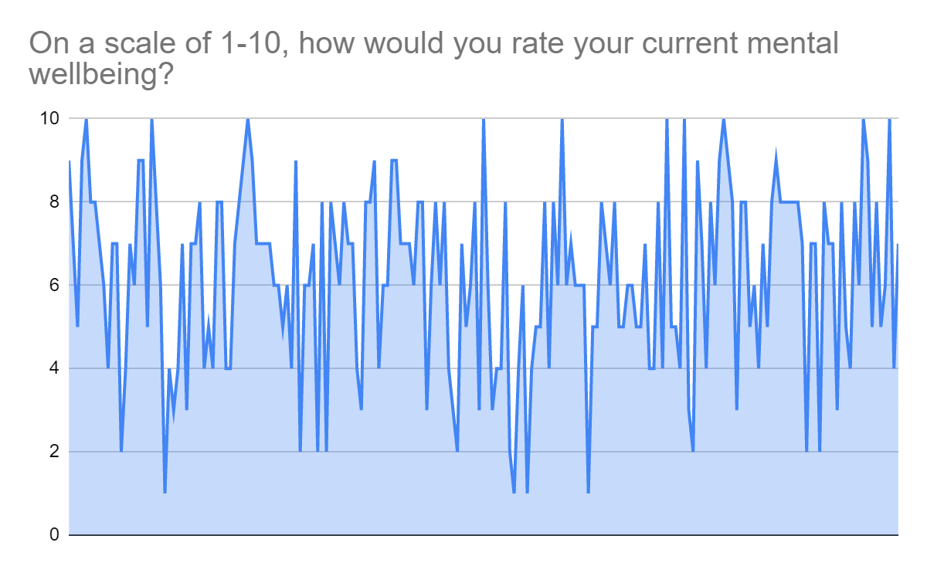
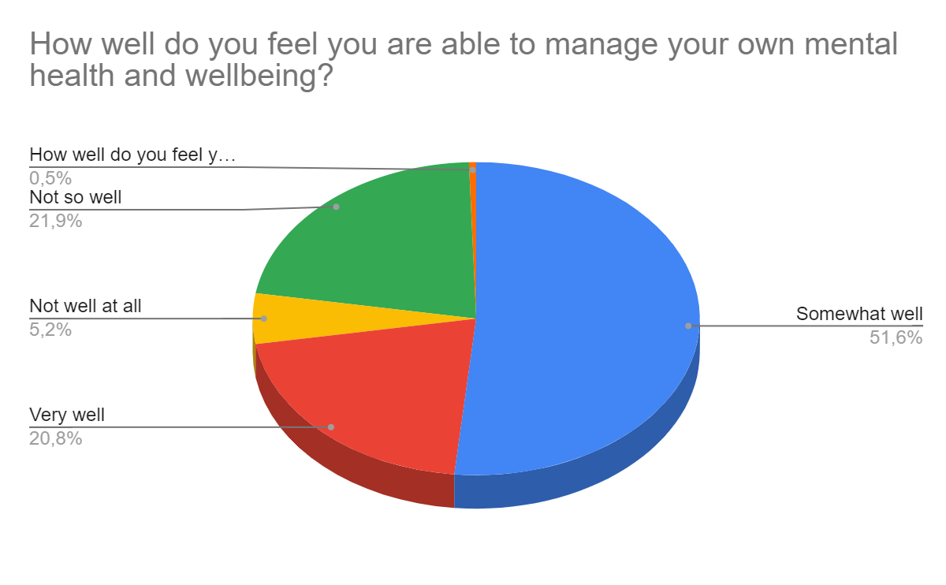
Are you really good at self care?
Question: What do you do to be mentally healthy? Can you really cope yourself? 25% cannot….

Slide 5
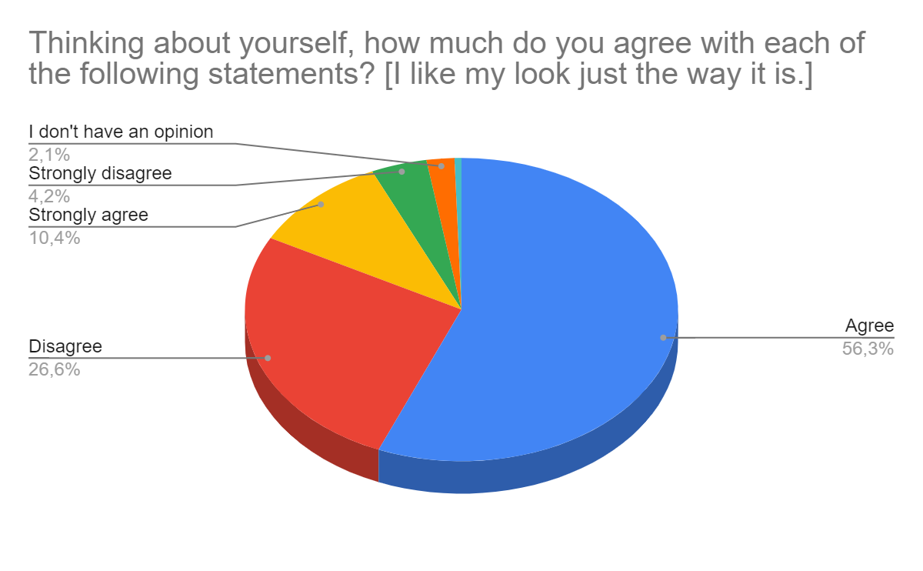
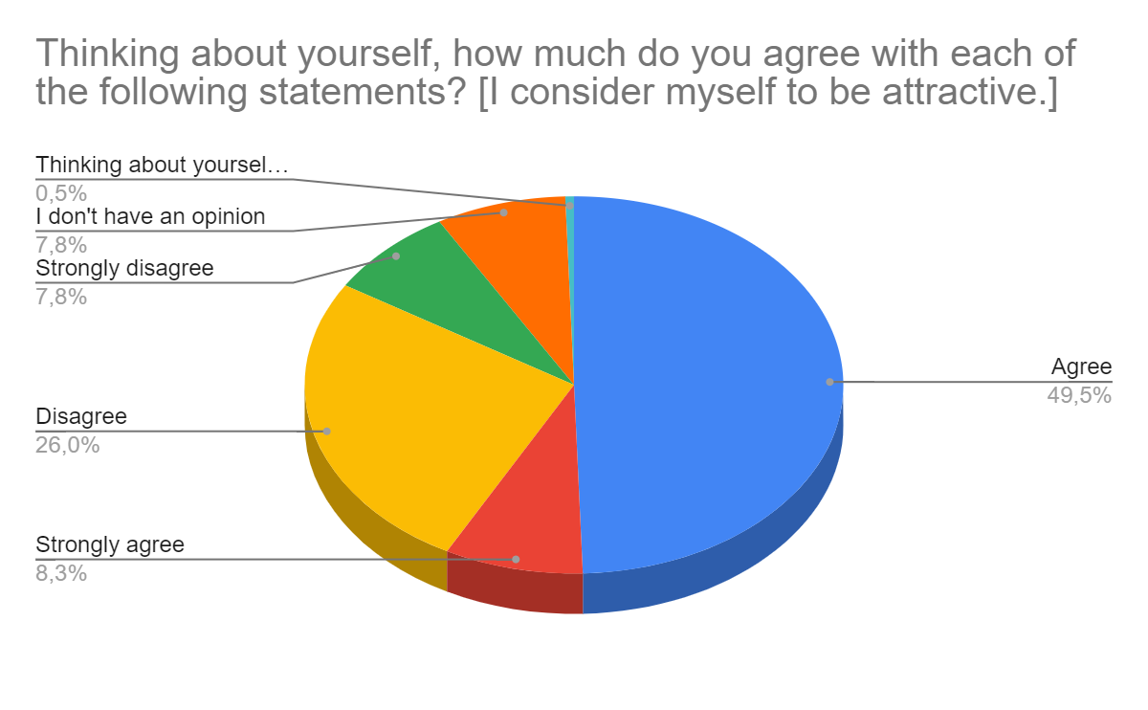
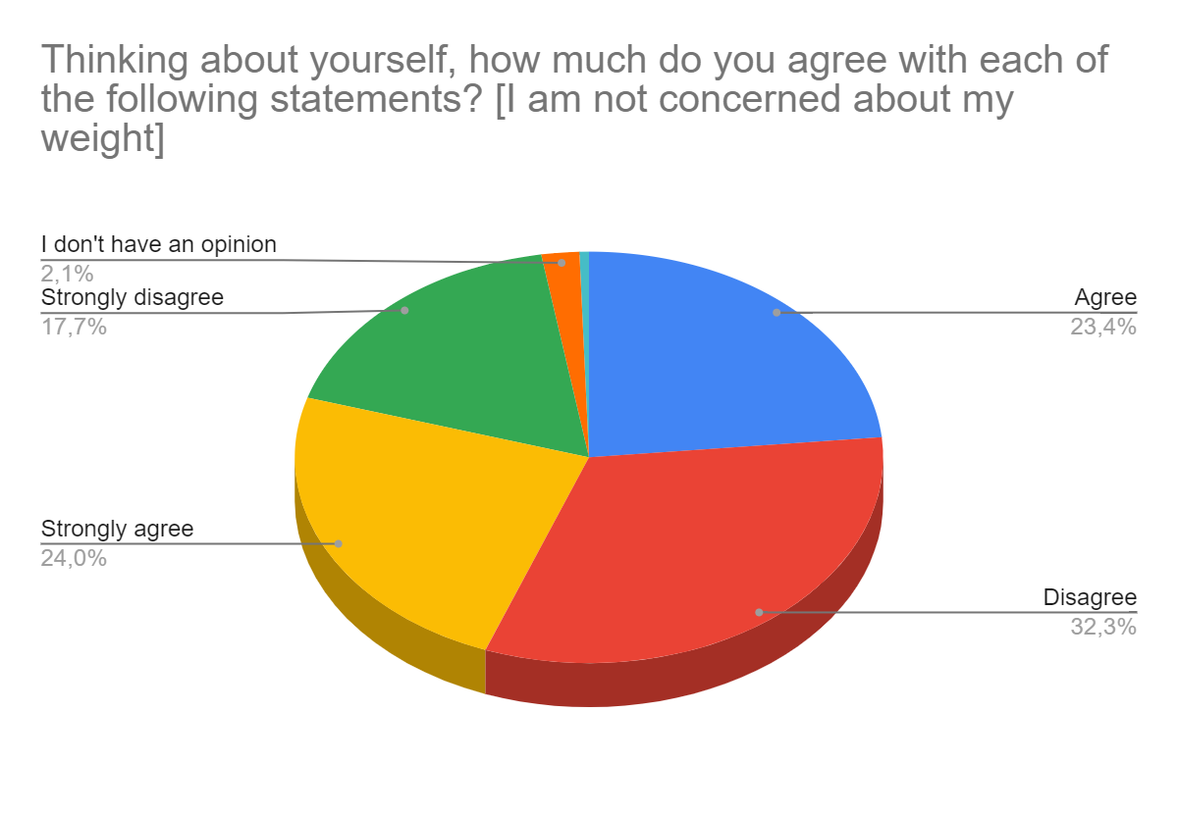
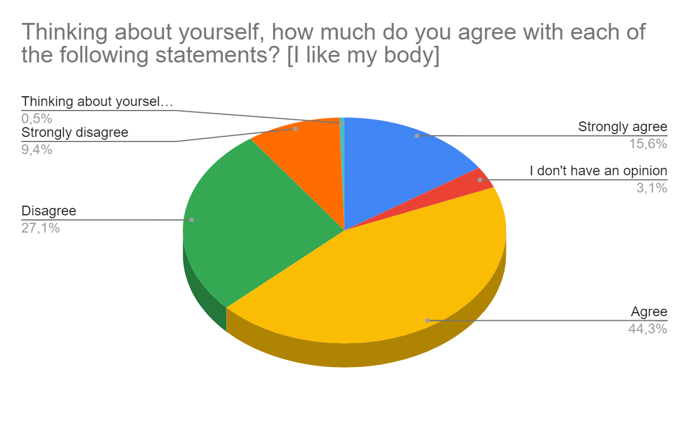
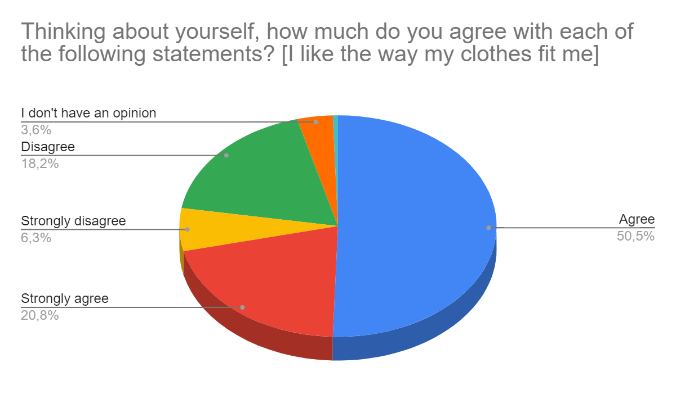
How do you see yourself??

Slide 6
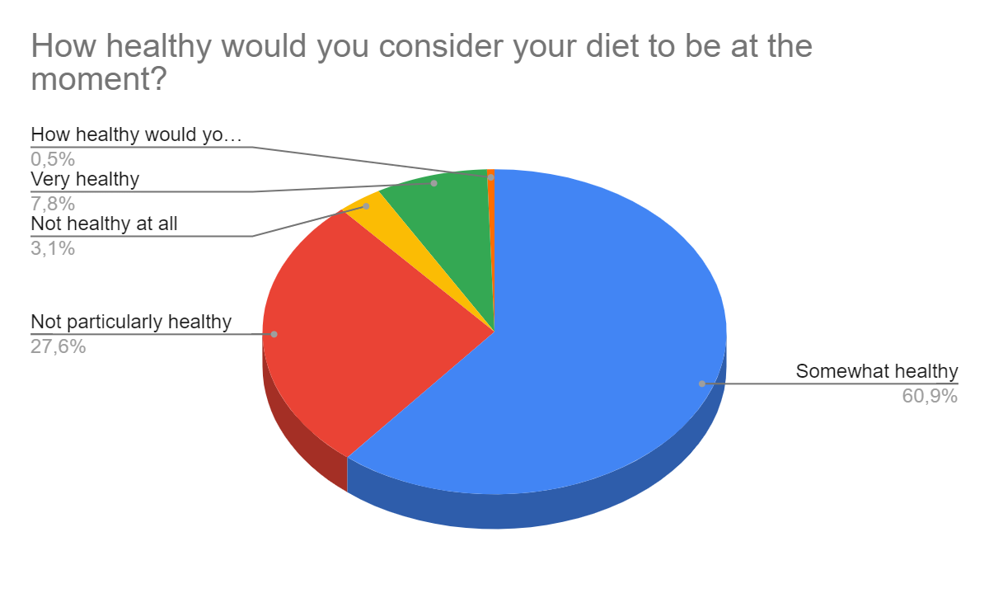
What kind of stuff do you eat?
Question: 30% of you know, you do not eat healthy. What do you eat, and why??

Slide 7
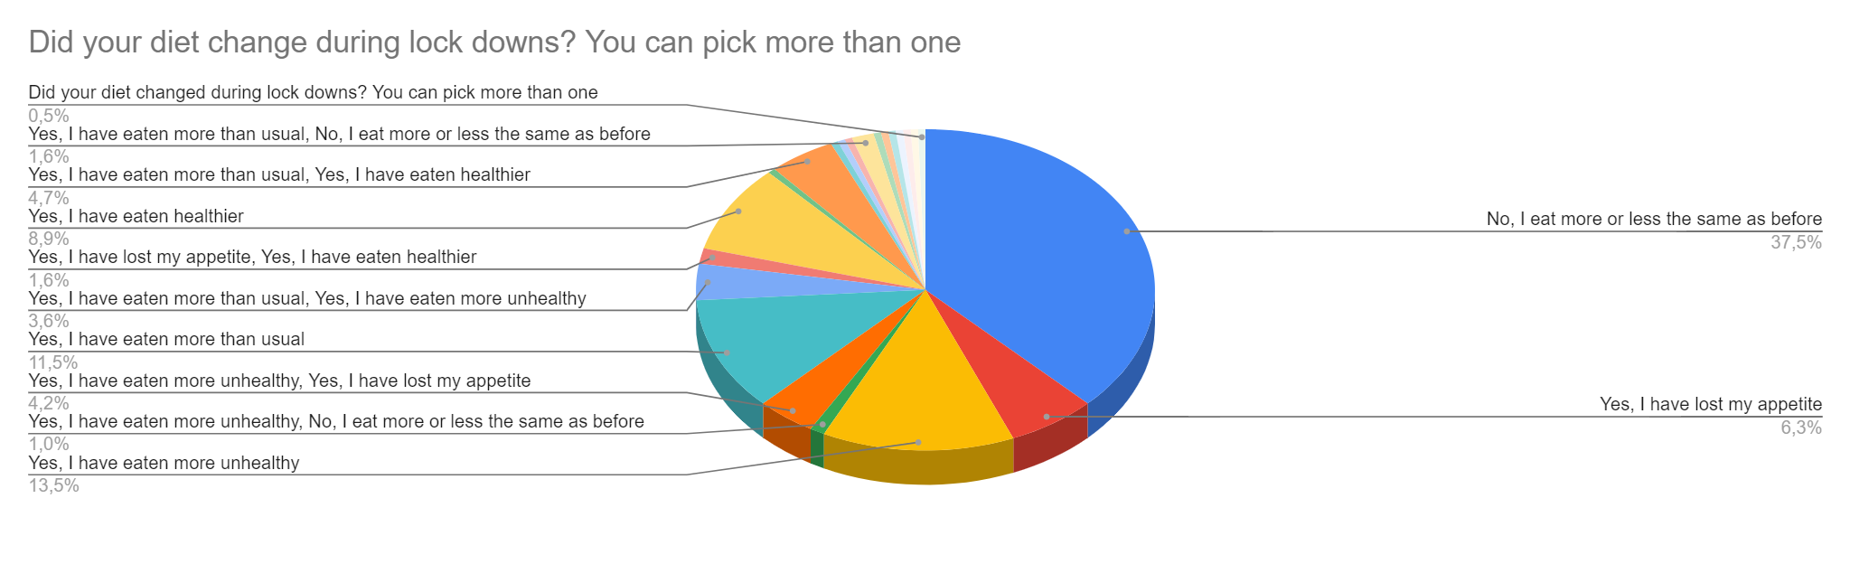
Are you a “feeling eater”?
Question: Why do you think that when the everyday life changes, eating habits also change?

Slide 8
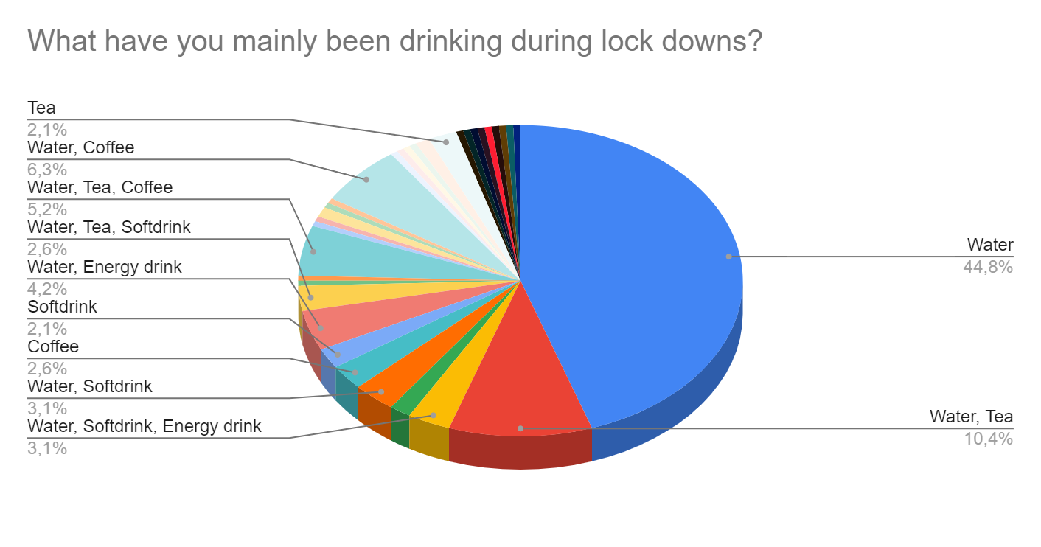
Drink water!

Slide 9
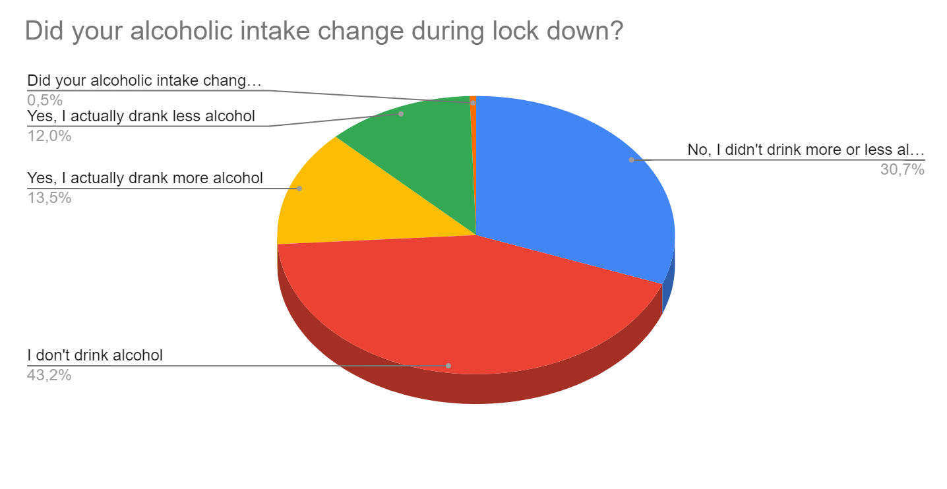
Well done, students!
Question: Why do you think some young people did increase their amount of alcohol during the pandemic?

Slide 10
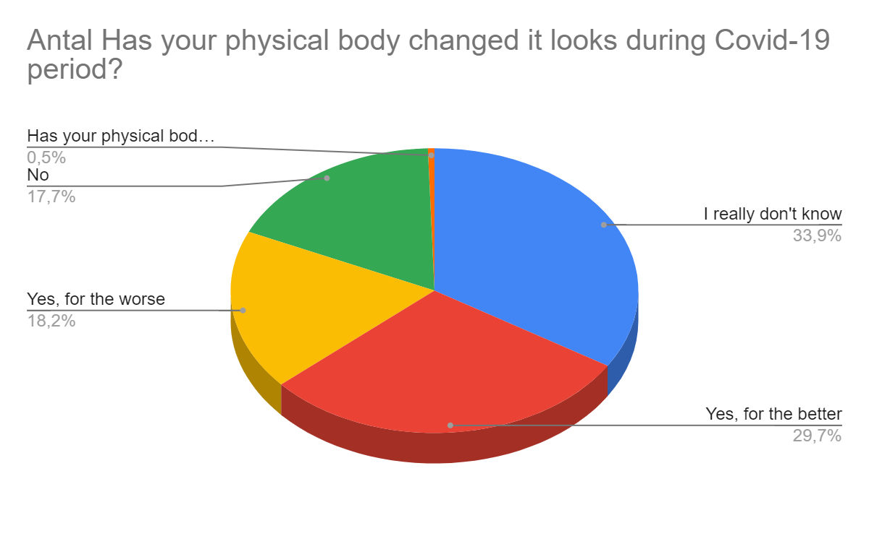
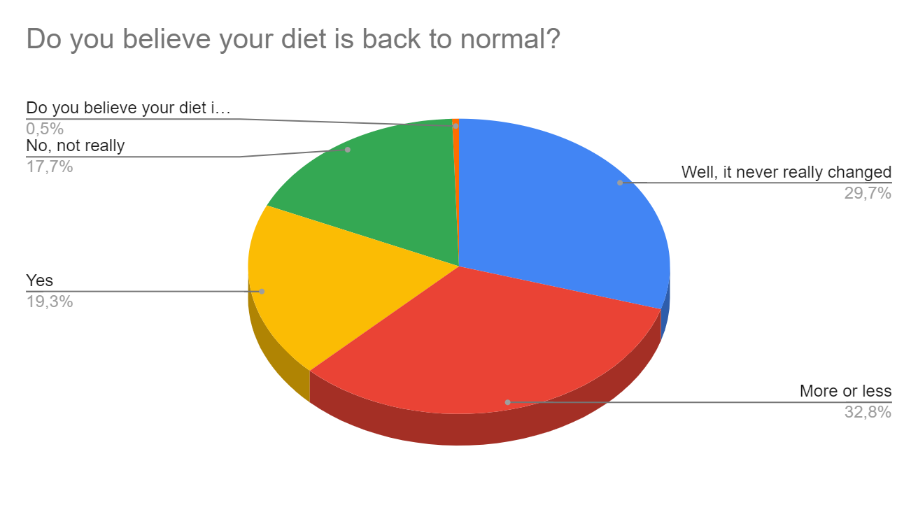
Worse body = bad eating?
Task: Talk about these two diagrams. Are those whose body changed for the worse the same as the ones whose diet is not back to normal?

Slide 11
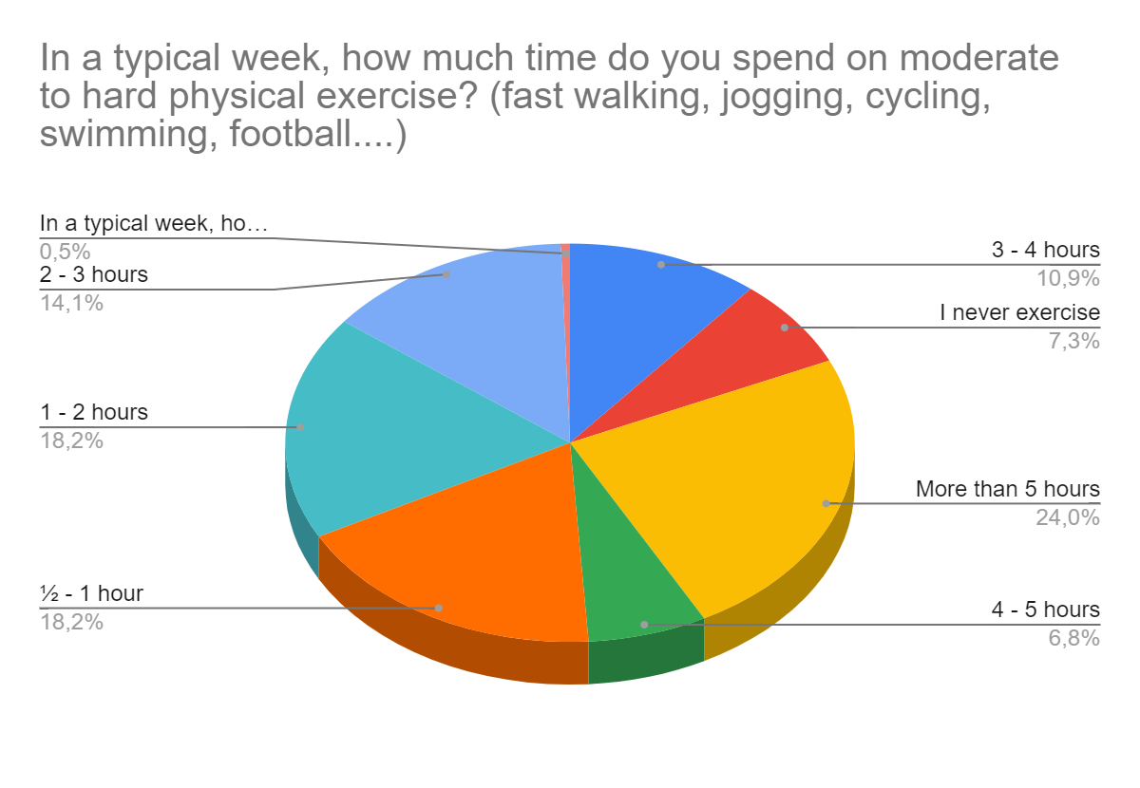
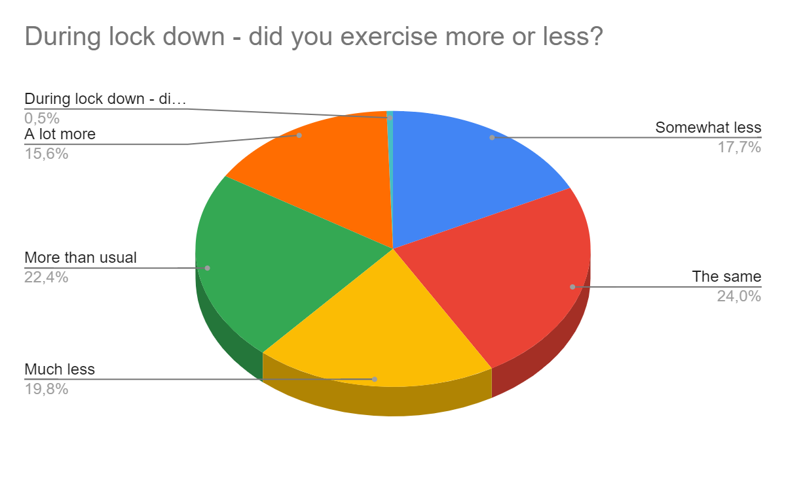
How much do you exercise??
Question: Why do you think exercise habits changed during lockdowns?

Slide 12
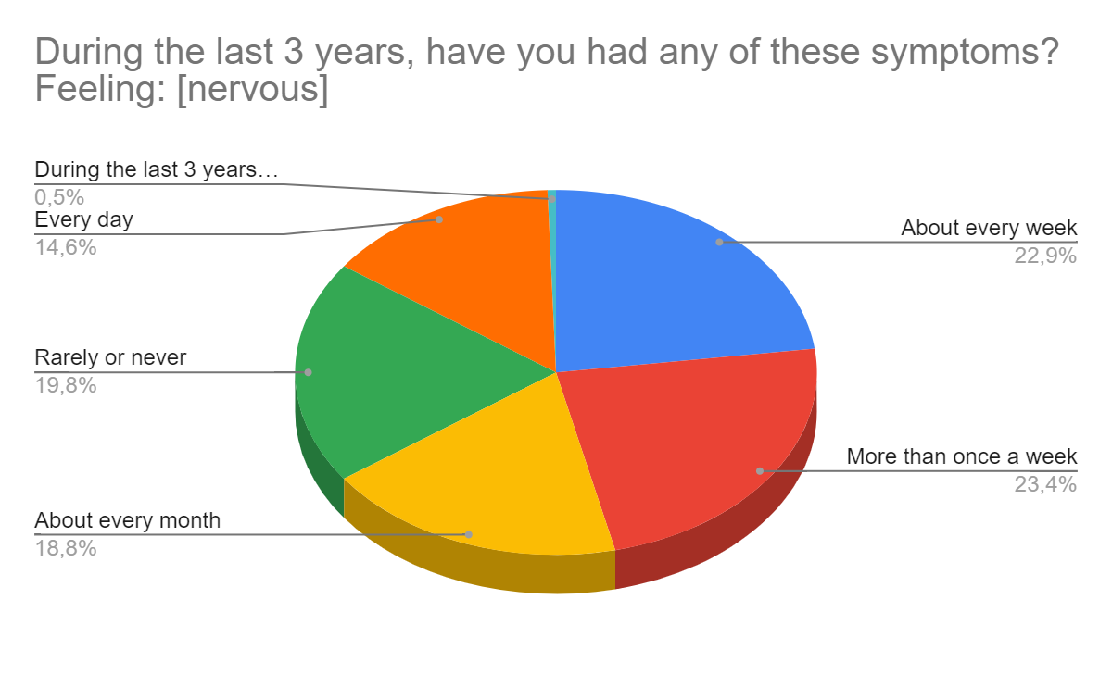
Talking about feelings…

Slide 13
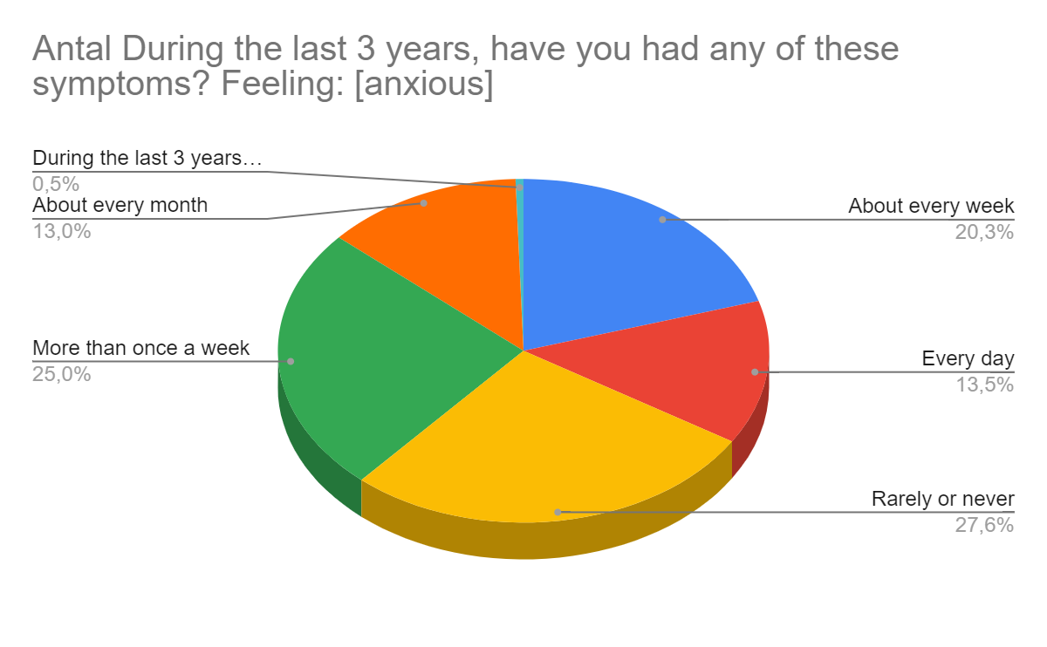

Slide 14
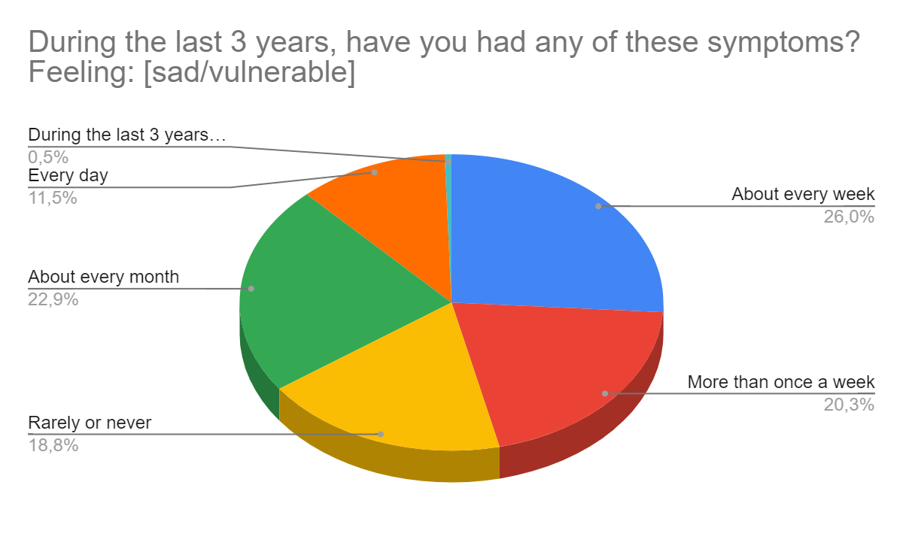

Slide 15
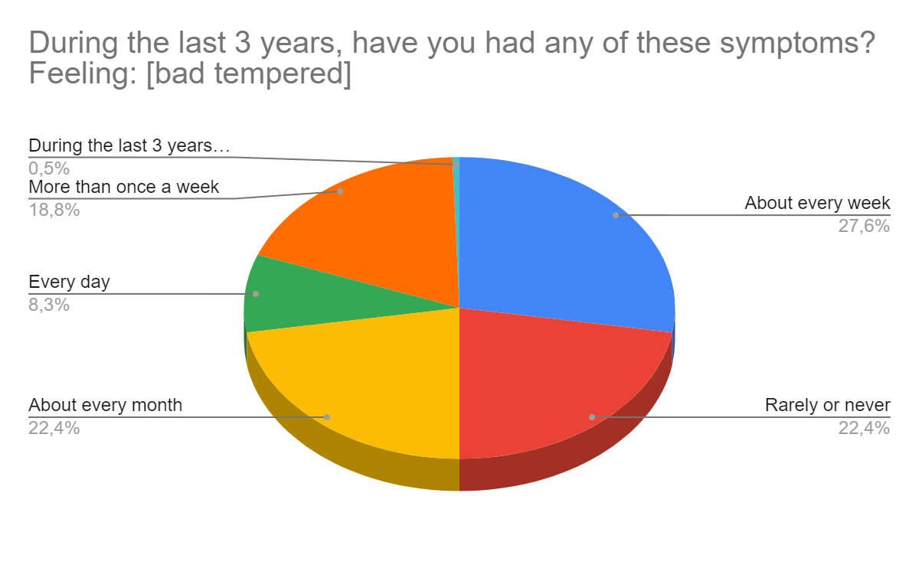

Slide 16
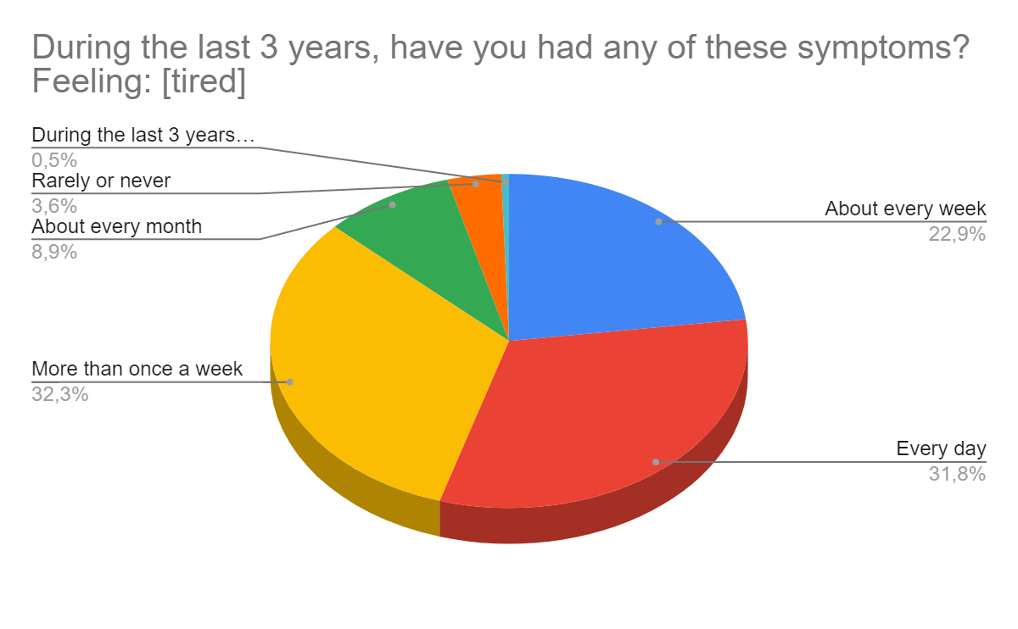

Slide 17
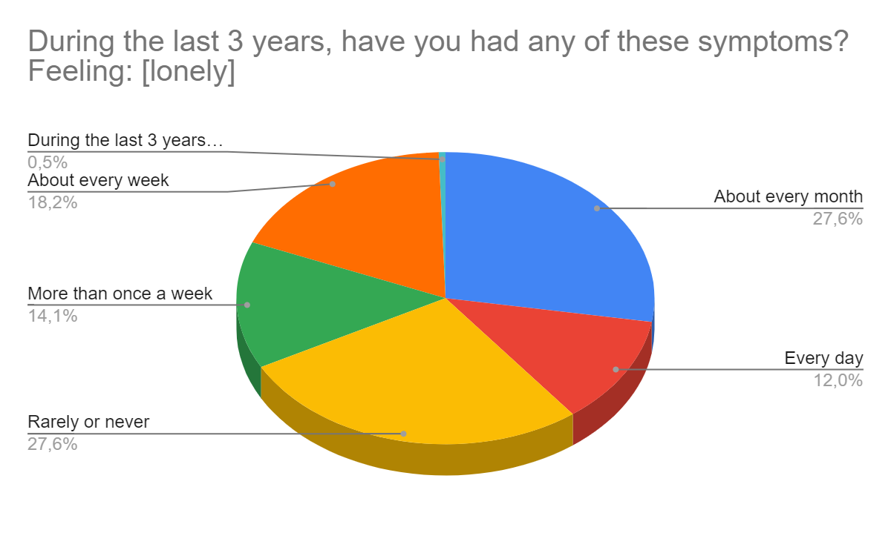

Slide 18
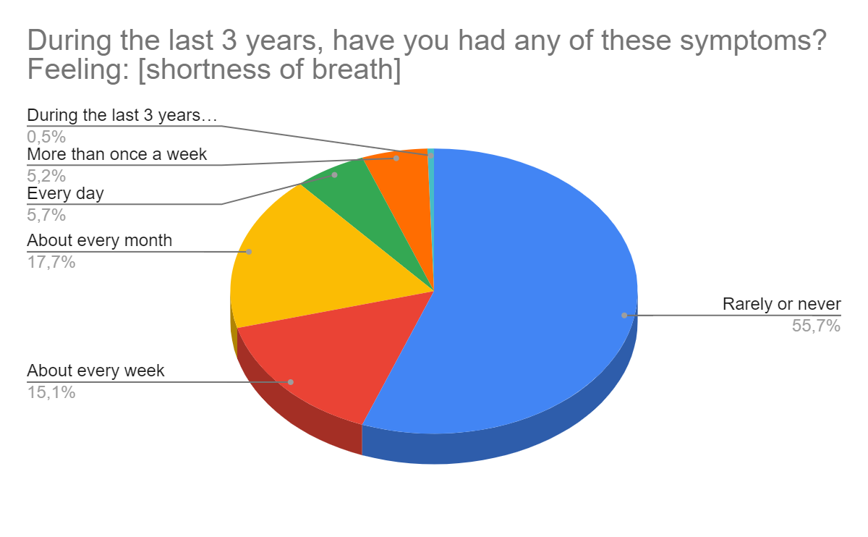

Slide 19
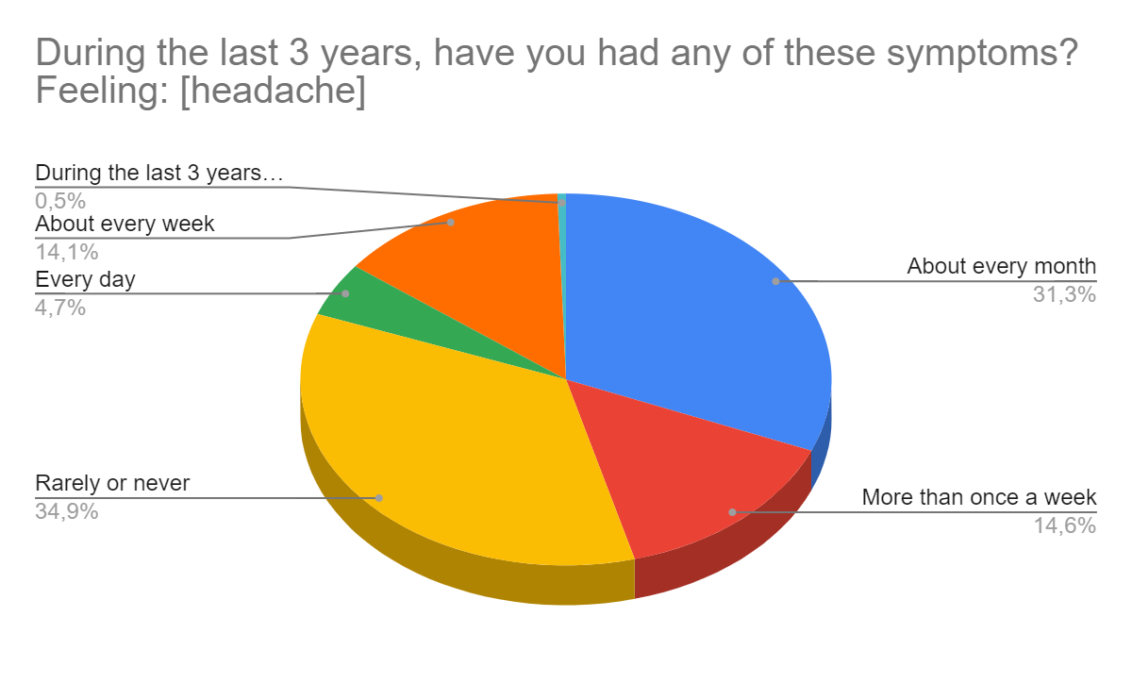

Slide 20
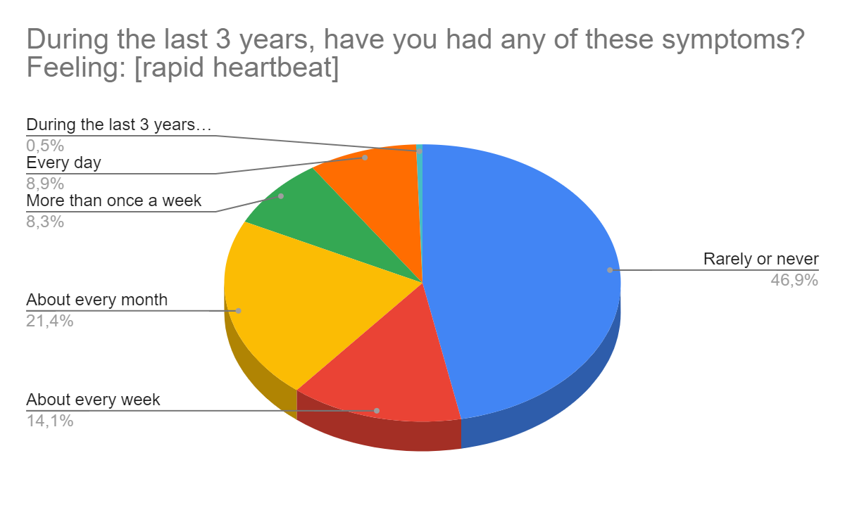

Slide 21
In plenum…RIGHT OR WRONG???
Statement: Covid/lock downs have a huge “responsibility” of young people mental wellbeing.
Right or wrong? Explain…
Statement: SoMe indirectly causes the way young people think and behave. Right or wrong? Explain..
Statement: The results of the above symptoms differs, depending on the country. Right or wrong?

Slide 22
Nervousness compared by country in %…
Country | Rarely/Never | Monthly | Once a week | More | Daily
NOR | 13,8 | 41,4 | 10,3 | 24,1 | 10,3
GER | 19,8 | 18,5 | 28,4 | 21,0 | 12,3
SPA | 6,9 | 10,3 | 34,5 | 44,8 | 3,4
TUR | 22,6 | 19,4 | 12,9 | 19,4 | 25,8
DEN | 37,9 | 6,9 | 17,2 | 17,2 | 20,7

Slide 23
Tiredness compared by country in %…
Country | Rarely/Never | Monthly | Once a week | More | Daily
NOR | 3,4 | 10,3 | 34,5 | 37,9 | 13,8
GER | 2,5 | 8,6 | 23,5 | 29,6 | 35,8
SPA | 3,4 | 6,9 | 20,7 | 44,8 | 24,1
TUR | 6,5 | 9,7 | 22,6 | 25,8 | 35,5
DEN | 6,9 | 6,9 | 17,2 | 31,0 | 37,9

Slide 24
Anxiousness by country in %...
Country | Rarely/Never | Monthly | Once a week | More | Daily
NOR | 20,7 | 17,2 | 27,6 | 24,1 | 10,3
GER | 32,1 | 13,6 | 21,0 | 23,5 | 9,9
SPA | 13,8 | 17,2 | 24,1 | 31,0 | 13,8
TUR | 22,6 | 12,9 | 12,9 | 32,3 | 19,4
DEN | 37,9 | 10,3 | 17,2 | 17,2 | 17,2

Slide 25
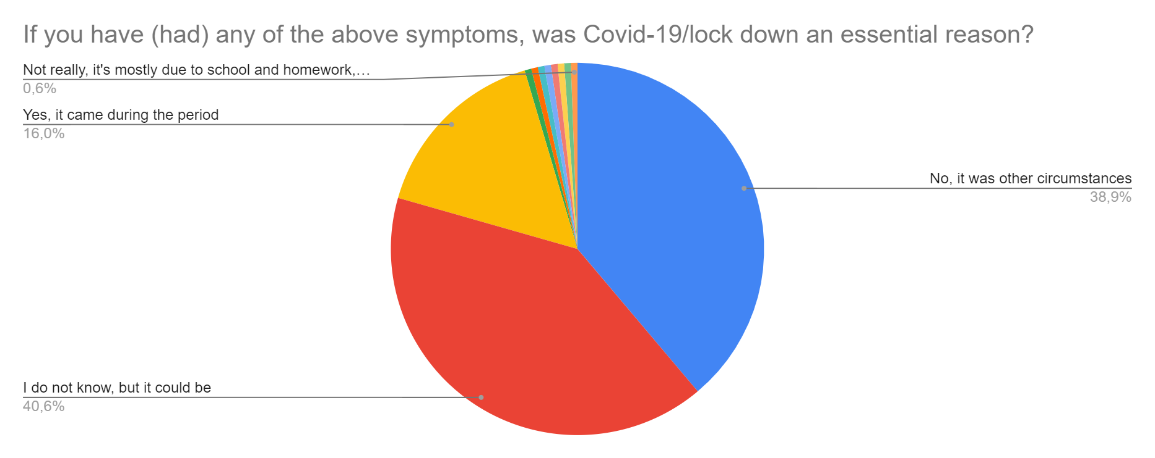
Reasons for the symptoms…

Slide 26
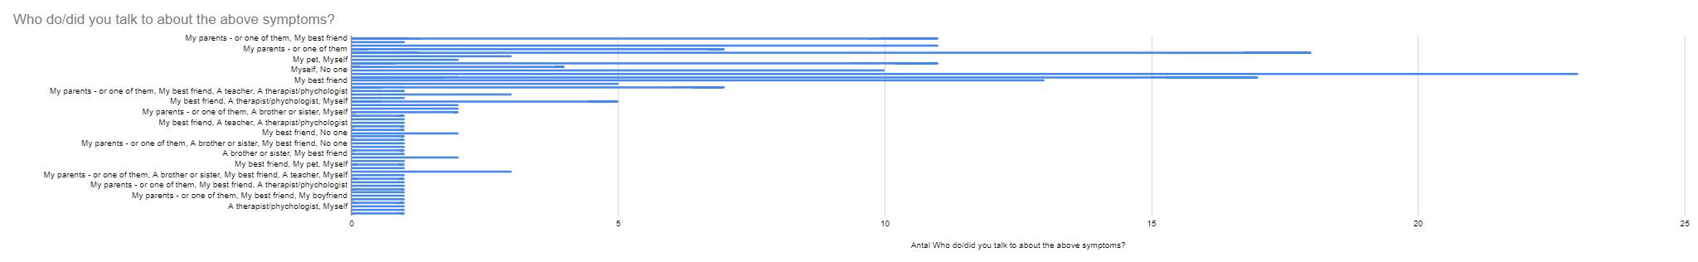
Question: From the above answers, not all young people talk to their parents about their feelings/symptoms. Why do you think it is like that? Also discuss if schools should/could do more to help students.

Slide 27
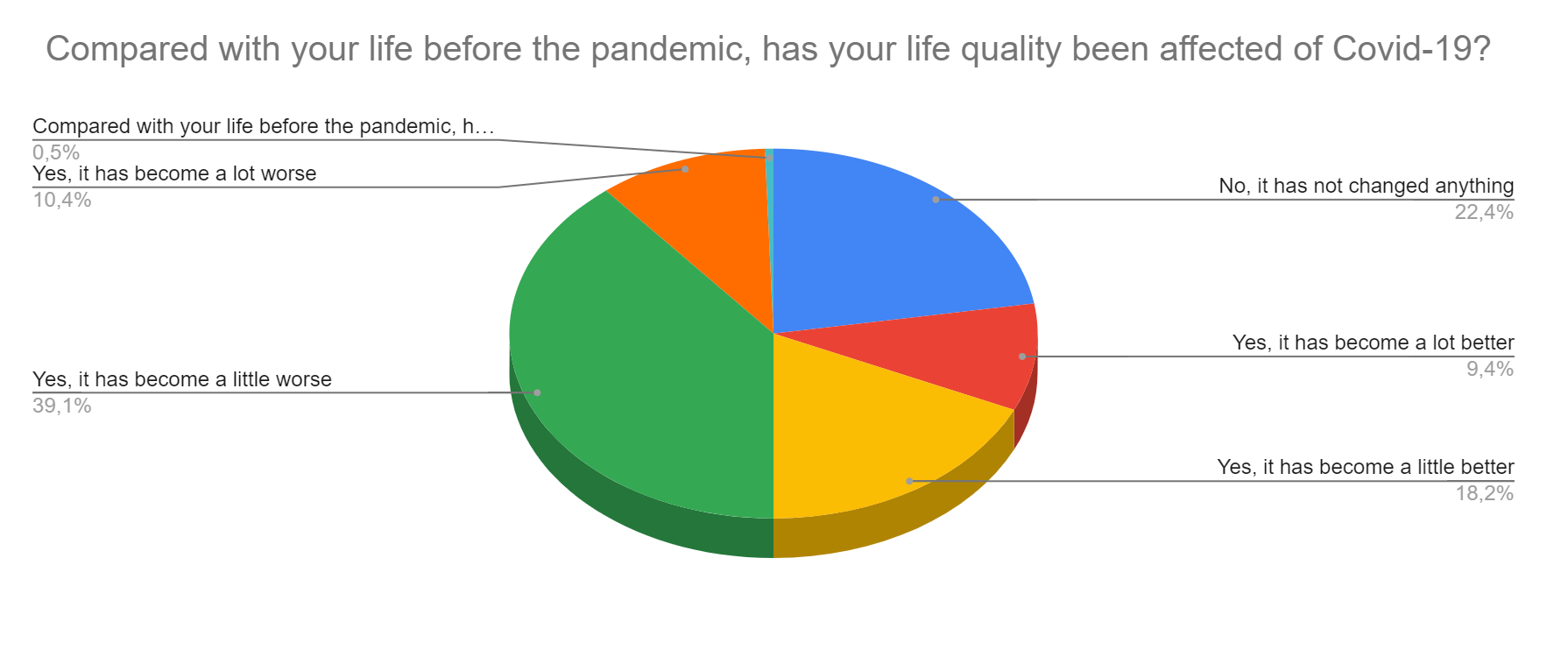
Will it ever be “normal” again?
For about half of you, life has become worse than before Covid-19, while 30% think it has become better. Discuss why you think this is so; what is worse and what is better? Also discuss the headline question…

Slide 28
In general, how happy or unhappy are you with life at the moment?
 | 1 | 2 | 3 | 4 | 5 | 6 | 7 | 8 | 9 | 10
Number | 3 | 4 | 14 | 14 | 32 | 22 | 35 | 43 | 27 | 4
1-5: 67 students (33%).
6-10: 131 students (66%)
In general it seems that most students’ lives are pretty good. How does that correspond to the numbers you heard above? What can “society” do to help those 33% - which actually is quite a high percentage?

